Slide 1

SENTENCE & SUMMARY COMPLETION

Slide 2
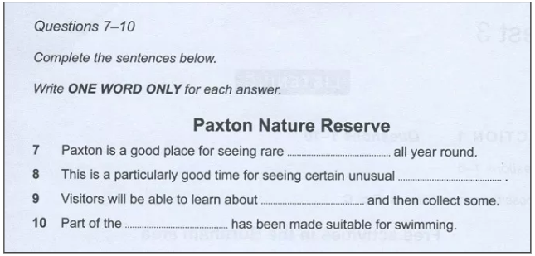
Sentence Completion

Slide 3
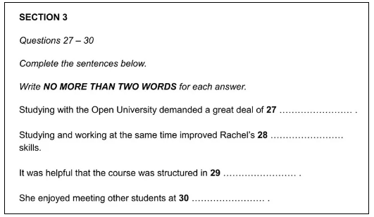
Sentence Completion

Slide 4
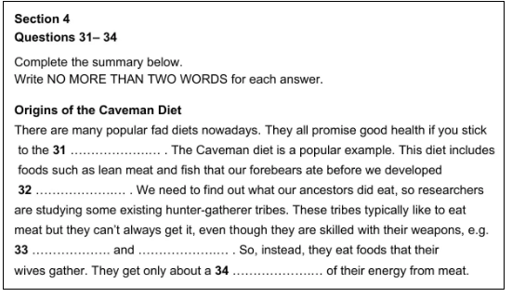
Summary Completion

Slide 5
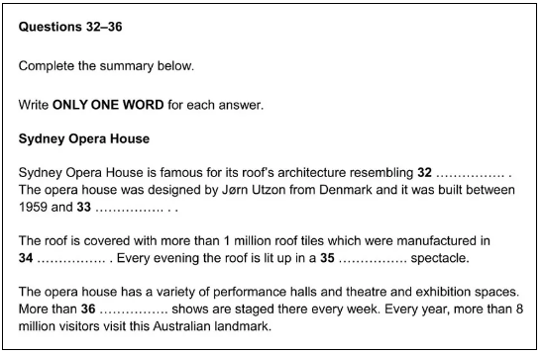
Summary Completion

Slide 6
Read the Instructions
Read the instructions carefully, paying particular attention to how many words you are allowed to write for the answer.
The instructions for our sample question state that you must,
Write NO MORE THAN TWO WORDS AND/OR A NUMBER for each answer.
If you write more than two words, your answer will be marked incorrect even if the information you give is correct.

Slide 7
Predict the Answers (Sentence)
Try to predict what the answers might be. This will focus your mind on what to listen out for in the recording.
Occasionally, you may be able to predict the actual word but it should certainly be possible to determine the type of word needed to fill each gap, such as,
a noun, an adjective, a verb
Can you predict what types of words that are missing in our sentence completion practice question?
Here are the 4 sentences:
Studying with the Open University demanded a great deal of 27 ………………… .
Studying and working at the same time improved Rachel’s 28 …………………… skills.
It was helpful that the course was structured in 29 …………………… .
She enjoyed meeting other students at 30 …………………… .
They will all be nouns.

Slide 8
Predict the Answers (Summary)
Try to predict what the answers might be. This will focus your mind on what to listen out for in the recording.
Occasionally, you’ll be able to predict the actual word but mostly it’s one or more of these things that you’ll be able to determine:
The type of information required, e.g. name of a person, place name, number, date.
The type of word required, e.g. noun, adjective, verb.

Slide 9
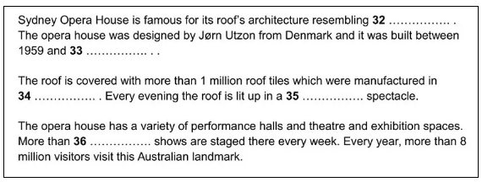
Predict the Answers (Summary)
Predictions:
32 – a noun
33 – a date
34 – a place name
35 – an adjective
36 – a number

Slide 10
Synonyms and Paraphrasing
Synonyms and paraphrasing will be used extensively in the recording. So, you will not only be listening for the exact words that are used in the sentences but also, different words and phrases that have the same meaning.
Rachel is probably not going to say,
Studying with the Open University demanded a great deal of ……. .
She will say it in a different way. For example,
My studies required a high level of ….
These synonyms have been used in this example:
demanded —-> required
great deal —> high level

Slide 11
Grammatical Accuracy
Check that each sentence is grammatically correct once you’ve added your answer. If it is not, then your answer is incorrect.
You may have to change the form of a word you identify as correct to make the sentence grammatically correct. For example,
Recording text: John – “I’m so frustrated that the insurance company are taking so long to settle my claim.
Sentence: John found it very (frustrating) that his accident claim was not sorted quickly.

